Slide 1
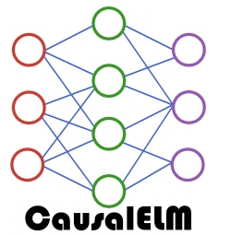

Causal Machine Learning with CausalELM
Darren Colby
dscolby.github.io/CausalELM.jl
Notes:
- We will be going through a couple examples so if you want to follow along with them you can get the Jupyter notebooks at the URL on the JuliaCon website or scan the QR code here

Slide 2
Outline
Potential Outcomes Framework
Motivating Examples
General Workflow
The ELM in CausalELM
List of All Estimators
Comparison with Other CausalML Packages
Way Forward
Notes:
We’ll briefly cover the potential outcomes framework in a noncomprehensive manner because the models we will discuss fall under this framework
Then the bulk of the presentation will be walking through a couple of motivating examples, which are in the notebooks
We’ll quickly tie it back to the general workflow in CausalELM
I’ll briefly talk about the other estimators that CausalELM implements that we won’t cover in the examples
Then I’ll talk a bit about how CausalELM differs from other causalML packages, especially EconML and others in Python
Finally, I’ll talk about what I see as a potential way forward for causal ML in Julia

Slide 3
Potential Outcomes Framework
Define x_{i} as a vector of covariates for each unit i
Define: T_{i} ∈ {0, 1} as the treatment indicator
When unit i is treated, T_{i} = 1
When unit i is not treated, T_{i} = 0
Define: Y_{i}(T_{i}) as the outcome for unit i as a function of T_{i}
When unit i is treated, we observe Y(1)
When unit i is not treated, we observe Y(0)
Notes:
Under the potential outcomes framework we’ll assume we have a dataset where x_is represent covariates or features for a unit I, T_is represent a treatment status, and Y_is represent an outcome
When unit I is treated T_i is 1 and when I is not treated it’s treatment status T_i is 0
This means that Y_i(1) is the outcome we observe when Y_i is treated and Y_i(0) is the outcome we observe when Y_i is not treated
We call these potential outcomes

Slide 4
Potential Outcomes Framework
The impact of treatment for unit i is just: τ_{i} = Y_{i}(1) − Y_{i}(0)
Problem: we only observe Y_{i}(1) or Y_{i}(0) but not both potential outcomes
Most models try to use assumptions, data structure, or research designs to overcome this problem

Slide 5

Motivating Example: Effect of 401(k) Plans on Net Worth
What is the effect of US 401(k) plans on net worth?
E[τ_{i} ]= E[Y_{i}(1) − Y_{i}(0)] = Average Treatment Effect (ATE)
Data comes from a 1994 study by Poterba et. al
Notes:
Now that we have a basic idea of what the potential outcomes framework is, let’s look at a motivating example
Financial regulators or policymakers might want to know whether they should encourage or more heavily regulate 401(k) plans
For those people not form the US, a 401(k) plan is a private pension plan that an employer and employee invest in and the employee can withdraw from during retirement

Slide 6
Motivating Example: Effect of 401(k) Plans on Net Worth
x_{i} includes age, income in USD, family size, marital status, dual earner status, indicator for a defined benefits pension, IRA participation indicator, and home ownership indicator
T_{i} denotes eligibility for a 401(k) plan
Y_{i} represents net financial assets in USD

Slide 7
Motivating Example: Effect of 401(k) Plan on Net Worth
Could use linear regression but we don’t know the functional form
Can also use double machine learning (Chernozhukov et. al, 2018)
No need to specify functional form
Uses any ML models to get treatment and outcome residuals and combines them in a final linear model

Slide 8
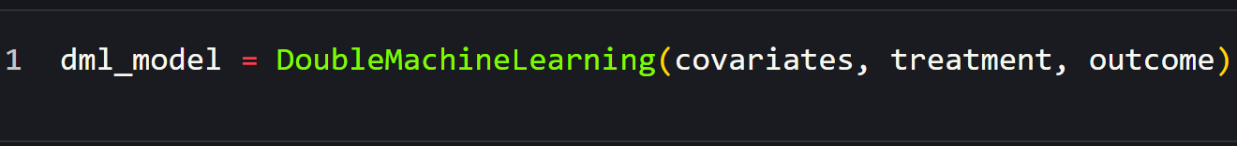
Motivating Example: Effect of 401(k) Plan on Net Worth
Instantiate a double machine learning model
Notes:
- The X, T, and Y arguments can be arrays or any data structure that implements the Tables.jl interface

Slide 9
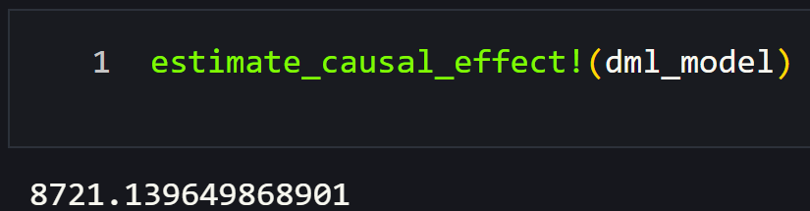
Motivating Example: Effect of 401(k) Plan on Net Worth
Estimate the ATE

Slide 10
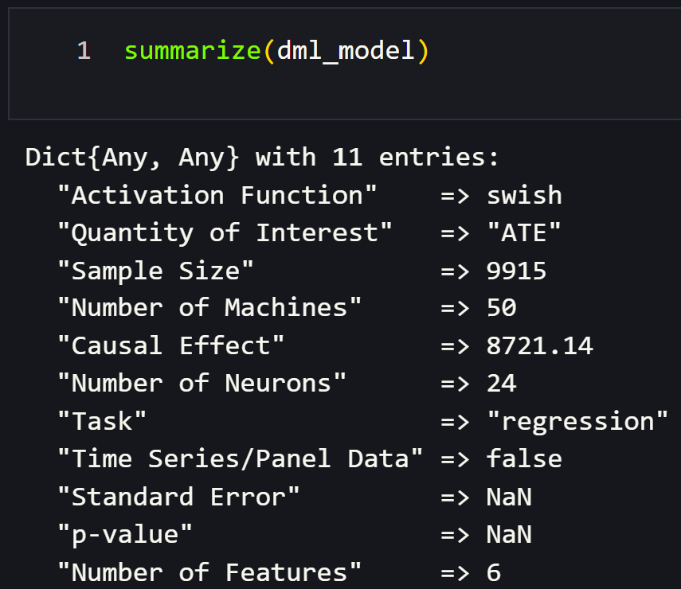
Motivating Example: Effect of 401(k) Plan on Net Worth
Get a summary from the model
Notes:
One thing to note is that the standard error and p-value are NaN
This is because with a lot of the estimators in CausalELM there are no asymptotic guarantees for the estimated parameters, so we instead use randomization inference
This means it will take a long time to calculate p-values and standard errors
If you want to calculate them, you can set the inference keyword argument to true

Slide 11
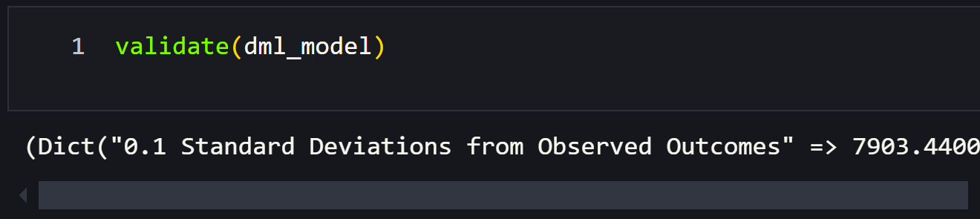
Motivating Example: Effect of 401(k) Plan on Net Worth
Validate model assumptions
Notes:
- Possibly the most important part of estimating causal effects is seeing whether your modelling assumptions hold or are at least not too sensitive
- In CausalELM we can use the validate method to get an idea of how robust our model is
- In this case, the first item we get is a dictionary that has estimated ATEs for models with simulated violations of the counterfactual consistency assumption
Ideally, these will not be too far off from the ATE we estimated
The next item is the E-value, which is a measure of how strong of an association a hidden confounder would need to have with the outcome to change our results
Finally, we get a matrix, which is hopefully empty, of observations that had a zero predicted probability of being assigned to either the treatment or control group
In the case of a continuous treatment, the treatment variable will be binarized to estimate propensity scores

Slide 12
Motivating Example: Effect of Aid on Taliban Violence
What is the effect of providing compensation to victims of violence in Afghan villages on future Taliban violence?
E[Y_{i}(1) − Y_{i}(0)]|x_{i}, T_{i}] = Conditional Average Treatment Effect (CATE)
Data comes from a 2019 study by Jason Lyall
Notes:
- We just saw how we can use CausalELM to estimate the ATE but what if we want to estimate heterogenous treatment effects?

Slide 13
Motivating Example: Effect of Aid on Taliban Violence
Could subset by groups and use linear regression
Would get very tedious
Would not use all the data
Can also use doubly robust estimation(Kennedy, 2022)
No need to specify functional form
Uses any ML models predict treatments, conditional outcomes, and combines them into final ML model

Slide 14
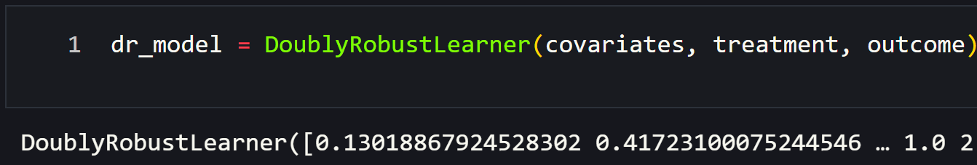
Motivating Example: Effect of Aid on Taliban Violence
Instantiate a doubly robust learner

Slide 15
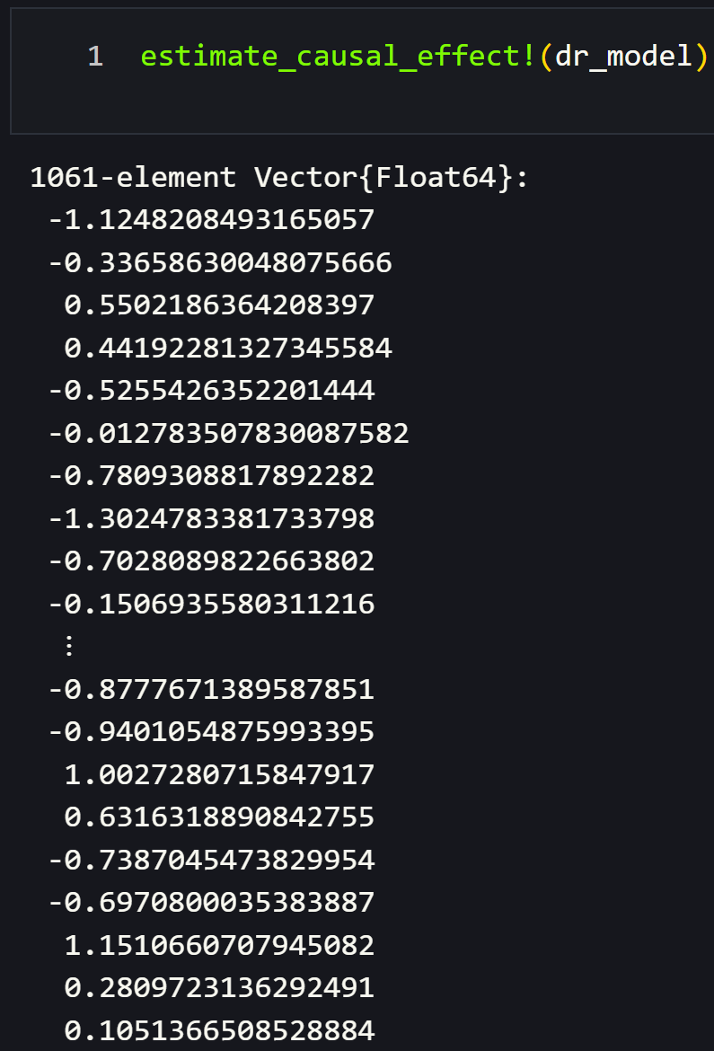
Motivating Example: Effect of Aid on Taliban Violence
Estimate the CATE

Slide 16
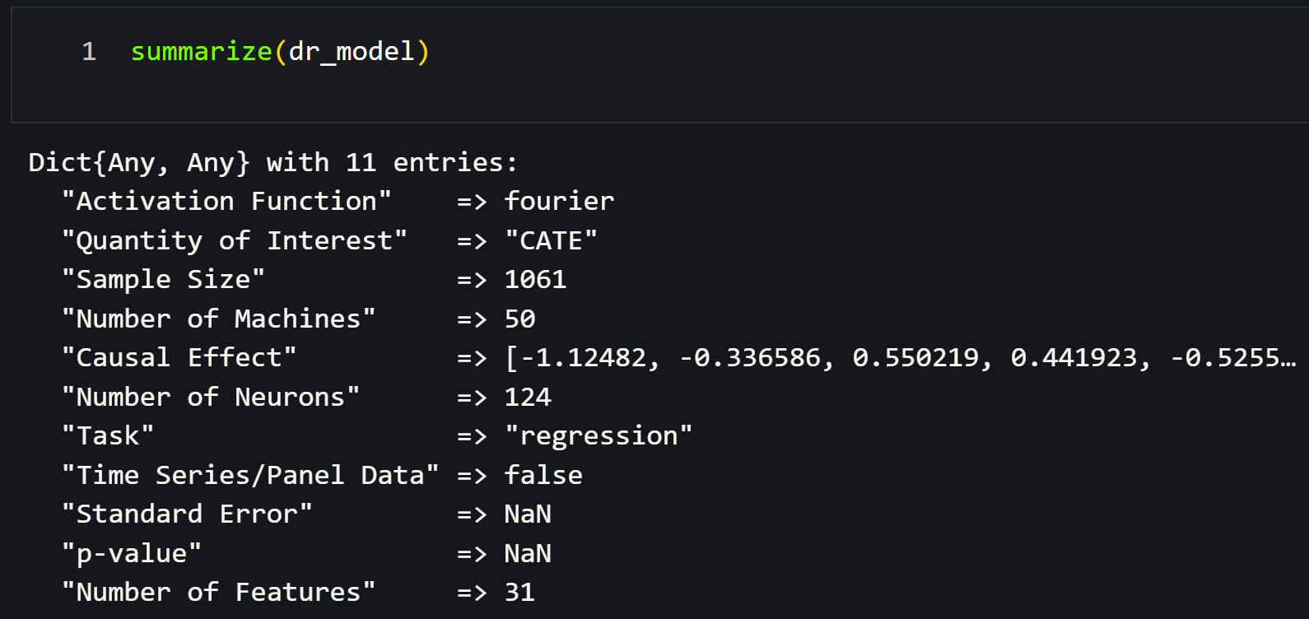
Motivating Example: Effect of Aid on Taliban Violence
Get a summary from the model

Slide 17
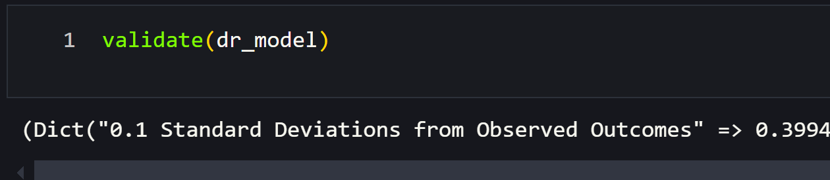
Motivating Example: Effect of Aid on Taliban Violence
Validate model assumptions

Slide 18
General Workflow
Instantiate
Instantiate a model
Estimate
Estimate the causal effect of interest
Summarize
Get a summary of the model
Validate
Validate modeling assumptions

Slide 19
The ELM in CausalELM
All CausalELM estimators need some kind of ML model
Base model in CausalELM is extreme learning machine (Guang-Bin et. al, 2006)
W_{feats, neurons} ~ U(-1, 1)
H = g(XW^{T})
β = H⁺Y
f(X_{Test}) = g(X_{Test}W^{T})β
Notes:
ELM is a special type of single layer neural network that uses randomized weights
To train an ELM we generate a matrix of random weights where the number of rows is the number of features and the number of columns is the number of neurons
Then we multiply the weights with the training features and apply an activation function, which gives us our hidden layer H
We get output weights by solving the least squares problem, multiplying the pseudoinverse of H with the targets to predict
Then, to make predictions we can multiply the test features by the weights, apply our activation function, and multiply this by the output weightst

Slide 20
The ELM in CausalELM
Ensemble of ELMs
Uses bagging strategy
Provides regularization
Enables probabilistic outputs
Activation functions
Provide regularization
Can greatly improve performance
Notes:
ELM is a special type of single layer neural network that uses randomized weights
To get predictions for some features X_test, we multiply X_test by W transpose, apply an activation function g, and multiply that output by some output weights, beta
Beta is learned during training via least squares optimization by multiplying the pseudoinverse of H with Y
And H can be thought of as a hidden layer that is the result of multiplying the training inputs by some weights and applying an activation function
Unlike a typical neural network, the weights are drawn from a uniform distribution and never change

Slide 21
List of All Estimators
Average Effect Estimators
Interrupted Time Series
G-computation
Double Machine Learning
CATE Estimators
S-learning
T-learning
X-learning
R-learning
Doubly Robust Estimation

Slide 22
Comparison with Other CausalML Packages
Simplicity
No required imports
Only need to know four functions
Randomization inference for all models
Less flexibility
Interdisciplinary
G-computation and E-value from epidemiology
Many estimators from econometrics literature
Randomization inference from work on causal inference
Lightweight
Written in Julia standard library

Slide 23
Way Forward
Notes:
Hopefully somebody in the room gets the Stepbrothers reference
In Julia there isn’t a highly developed ecosystem for causal ML like in Python
This means we have an opportunity to create a simple interface in the spirit of Tables.jl for causal ML
Then anyone can easily estimate causal effects using a simple workflow like the one used by CausalELM
Could also take this even further and make a metapackage like MLJ

Slide 24

Thank you!

